Slide 1


Romantic Relationship with POSTMAN
By Földi Krizsán Ildikó

Slide 2

Motivation for starting API testing:
It all started with a job interview. At a job interview, they asked the question:
Mr. Senior: "How well do you know (the) Postman?".
Me: "Well... well... I haven't really made any requests for that sort of thing..."
Mr. Senior: "You should have..."

Slide 3



So I asked some friends for advice
01
02
03
YouTube
Google
GPT

Slide 4




Project from YouTube
Postman Beginner's Course - API Testing by
Over 2 hours of video about Posman
+ commercials every 5 minutes
{{Don’t forget the elections}}

Slide 5

It has a dark mode
I knew I’d like it
IN

Slide 6

First hour of video is revising the basics of API testing:
Collections
Variables (set url as Variable)
Parameters (?type=fiction)
Random test data (“{{$randomFullName}}”)
Authentication (token)
Requests : GET, PUT, PATCH, DELETE
Just the regular things, nothing special…

Slide 7
Second hour of video is test automation:
Test in JS ( pm.test(“Something”, ()=>{ some tests }) )
Extracting data from the response (const resp = pm.response.json();)
Set variables (pm.globals.set("variable_key", "variable_value");)
Collection runner
Request execution order ( postman.setNextRequest(“nameOfNext”) )
Postman monitors (run every week… SET initial value for variables!)
Newman
CI/CD overview
Some of them are very scary…

Slide 8
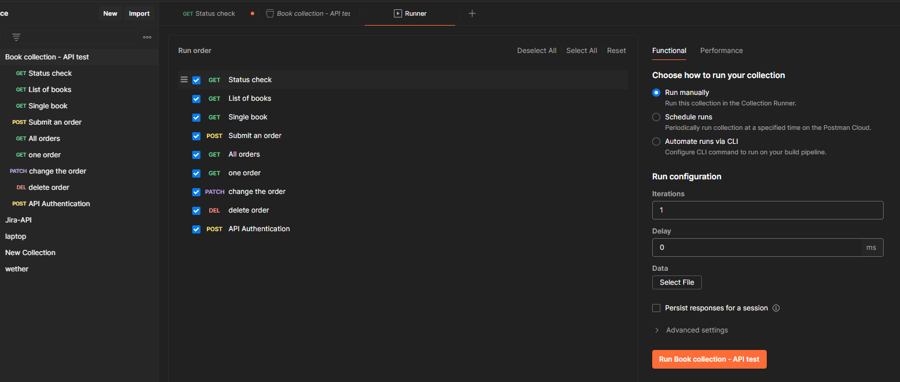

Results of the tutorial:

Slide 9


Testing JIRA API!!!!!!
I had to find the correct Jira REST API
https://<username>.atlassian.net/rest/api/3/<something>
Authorization was a nightmare
“I do not have a password!!!!!!!!!!!!!!”
“Oh, to use token as password???”
The documentation is not for toddlers
The body from dokumentation is not working, somebody HELP!!!
: “I will help…”

Slide 10
What did I achieve with Postman?
Even though Jira wasn't thrilled about this connection at first...
I get all the events from my Jira account
I get all the issues from my Jira account
I set the key of first issue as a Collection variable
I use this variable to get the details of issue
I can create an issue in my First project
I save the key of that issue
I can delete the created issue - nevel leave trash after testing!

Slide 11
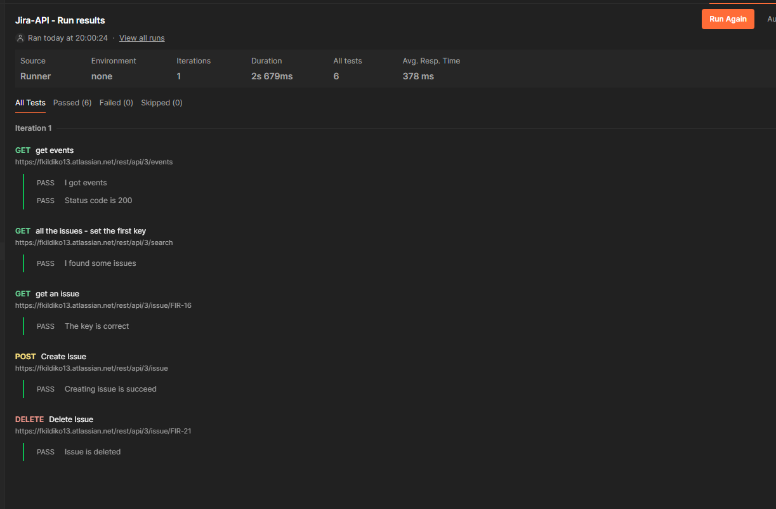

Results:

Slide 12
I thought it was too early to:
Debug monitors
Slow down a bit Mr. Postman
Use global variables instead collection variables
Why not skip the next test?
Newman
Uhh… Ohh…It will just be too much now
Reports
I'm really looking forward to this part.
CI/CD
No comment…

Slide 13
Thanks!
Do you have any questions?

